Slide 1

Introduction Data-X: A Course on Data, Signals, and Systems
Data ^{X}
About Me:
Ikhlaq Sidhu Chief Scientist & Founding Director, Sutardja Center for Entrepreneurship & Technology IEOR Emerging Area Professor Award, UC Berkeley

Slide 2
Welcome to Data-X
First Class: Introductions (15 min)
Kevin Bozhe Li, kbl4ew@berkeley.edu (GSI)
Alexander Fred-Ojala, afo@berkeley.edu (Visiting Scholar)
Nathan Cheng: ncheng@berkeley.edu (Tensor Flow) and other module experts
Others have contributed..
What is Data-X (30 min)
Pre-requisite Discussion (30 min)
HW for next Week (15 min)
High Level Overview of Data (1.5 hours)
Remaining Time – Install your coding environment, get help if needed from GSI and teaching team.
Notes:
* First class
* Its pretty full.
* The class is experimental - first time.
> some people will drop
- need to already know python and probability
- Take in Fall - if possible
- We may be able add add a few more seats, but we are limited by number projects that we can manage and advise.
Today...

Slide 3
What is Data-X?
Math Quantitative
Open Source CS Tools
A Course
Applied Project
Industry Perspective, Social Applications, Customer Driven
Real Applications with Code Samples

Slide 4
What is in it
Common Open Source CS Tools:
Numpy, SciPy
Pandas
TensorFlow, Sklearn
SQL to Pandas
NLP / NLTK
Matplotlib
Quantitative
Prediction: Regression
ML Classification: Logistic, SVM.. Trees, Forests, Bagging, Boosting,..
Entropy / Information Topics
Deep Learning examples, including CCNs
Correlations
Markov Processes
LTI Systems: Fourier, Filters where applicable
Control Models where applicable
Building Block Code Samples
Webscraping
Stock market live download, simple trading
Convolutional Neural Networks
Next Word Predictor, Spell Checking
Reccomendation
Web Crawler
Chatbot, E-mail
Social net interfaces including twitter
Often: Working Code First
Fill In Theory After
Data-X: This class will help you combine math and data concepts
Not Data-X: This class is not a big data class.
Notes:
We usually start with a code sample or tool, then drop in to the math behnd it or the math that you would need to make use of it

Slide 5
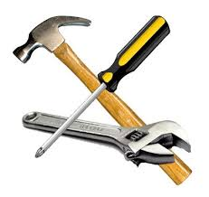



What is this class
Make the Tools
Use the Tools
(Optimally)
Architect the System
Why and how you build
Most CS
This IEOR Course
Sutardja Center

Slide 6
How the Data-X Course Works:
Insightful Story
Solution
Lectures: Quant Models and CS Code Examples
Brainstorm Challenge
and Validate (4)
Propose Low Tech Solution (1)
Execute * Iterate
BMoE Reflections
Agile Spring (8)
Demo or Die (1)
Team: Tech Lead, Product Lead + 2-4 Experts
CS Tool Industry Lectures – Video Flip
Notes:
And, did you know what you wanted?

Slide 7
What we cover and what we won’t
Yes
No
Tools for Data and Math
Open source tool sets
Use of ML and Natural Language tools
Cookbook Applications for common system
A real life integrated project
Operational scalable code for any field or application
Enough to be dangerous
A system’s viewpoint
Very large Large Data Sets
Hadoop
Spark Pipelines
BDAS Stack
Ability to write an ML or Natural language framework
Detailed data science
Sparse data techniques
A purely CS view
A purely statistician’s view
In-depth Mathematic

Slide 8
Basic Tools to Get Started
Available with Anaconda Environment (available for free):
Python, we will use version 2.7, pre-requisite to class
NumPy, array processing for numbers, strings, records, and objects
Pandas, Powerful data structures and data analysis tools
SciPy, Scientific Library for Python
Matplotlib, Python 2D plotting library
Ipython - Productive Interactive Computing
Environment includes:
Jupyter – Interactive web based python
Spyder – code development environment with editor

Slide 9
Introduction Data-X: A Course on Data, Signals, and Systems
Data ^{X}
About Me:
Ikhlaq Sidhu Chief Scientist & Founding Director, Sutardja Center for Entrepreneurship & Technology IEOR Emerging Area Professor Award, UC Berkeley

Slide 10
A High Level Overview of Data

Slide 11

Basic Concept of Working with Data
Data Wrangling
In Production

Slide 12


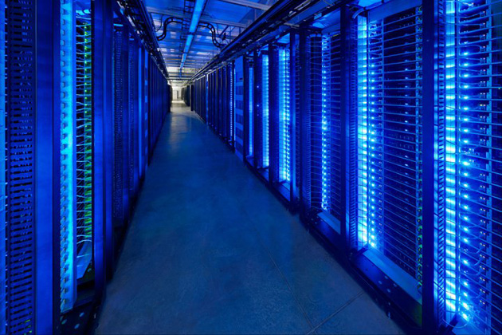
Human Interpretation of Data
Large Sets of Data
Human
Insight
Machines

Slide 13
How did data become such a big deal?

Slide 14

Model Examples for things that normally require human judgment
Scoring Wine
Wine quality =
12.145 +
0.00117 x (winter rainfall ) +
0.0614 x (average growing season temperature) –
0.00386 x (harvest rainfall)
Oren Ashenfelter, Princeton. Now used by Christies Auction House

Slide 15
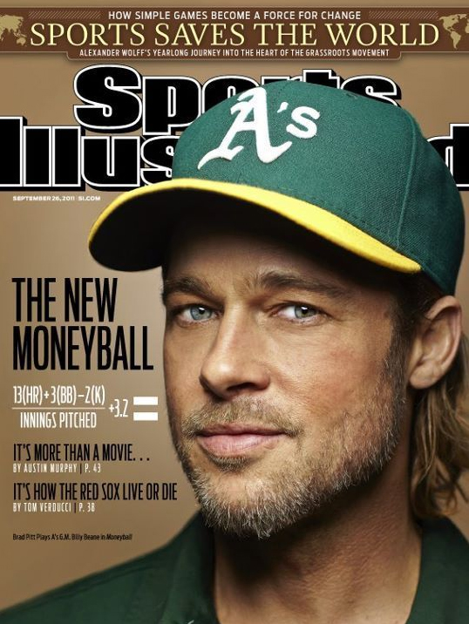
Competitive Advantage in Sports
Money Ball:
How to measure and predict baseball performance
Oakland Athletics baseball team and its general manager Billy Beane
A: Watch and talk with hundreds of players
B: Runs created =
(hits + walks) x Total Bases /
(At Bats + Walks)
Now: Basketball, Football, and soon every other sport
Notes:
Moneyball: The Art of Winning an Unfair Game is a book by Michael Lewis, published in 2003, about the Oakland Athletics baseball team and its general manager Billy Beane. Its focus is the team's analytical, evidence-based, sabermetric approach to assembling a competitive baseball team, despite Oakland's disadvantaged revenue situation. A film based on the book starring Brad Pitt was released in 2011.
Synopsis[edit source | editbeta]
The central premise of Moneyball is that the collected wisdom of baseball insiders (including players, managers, coaches, scouts, and the front office) over the past century is subjective and often flawed. Statistics such as stolen bases, runs batted in, and batting average, typically used to gauge players, are relics of a 19th-century view of the game and the statistics that were available at the time. The book argues that the Oakland A's' front office took advantage of more analytical gauges of player performance to field a team that could compete successfully against richer competitors in Major League Baseball (MLB).
Rigorous statistical analysis had demonstrated that on-base percentage and slugging percentage are better indicators of offensive success, and the A's became convinced that these qualities were cheaper to obtain on the open market than more historically valued qualities such as speed and contact. These observations often flew in the face of conventional baseball wisdom and the beliefs of many baseball scouts and executives.
By re-evaluating the strategies that produce wins on the field, the 2002 Athletics, with approximately US$41 million in salary, were competitive with larger market teams such as the New York Yankees, who spent over US$125 million in payroll that same season. Because of the team's smaller revenues, Oakland is forced to find players undervalued by the market, and their system for finding value in undervalued players has proven itself thus far. This approach brought the A's to the playoffs in 2002 and 2003.
Several themes Lewis explored in the book include: insiders vs. outsiders (established traditionalists vs. upstart proponents of sabermetrics), the democratization of information causing a flattening of hierarchies, and "the ruthless drive for efficiency that capitalism demands." The book also touches on Oakland's underlying economic need to stay ahead of the curve; as other teams begin mirroring Beane's strategies to evaluate offensive talent, diminishing the Athletics' advantage, Oakland begins looking for other undervalued baseball skills such as defensive capabilities.
Distribution of team salaries in 2002. Team salaries ranged from about $35 million (the Tampa Bay Rays) to about $120 million (the New York Yankees)
The Oakland Athletics had the third-lowest team payroll in the league (about $40 million) marginally higher than that of the Montreal Expos, whose franchise was transferred to the Washington Nationals in 2005.
Moneyball also touches on the A's methods of prospect selection. Sabermetricians argue that a college baseball player's chance of MLB success is much higher than a traditional high school draft pick. Beane maintains that high draft picks spent on high school prospects, regardless of talent or physical potential as evaluated by traditional scouting, are riskier than if they were spent on more polished college players. Lewis cites A's minor leaguer Jeremy Bonderman, drafted out of high school in 2001 over Beane's objections, as but one example of precisely the type of draft pick Beane would avoid. Bonderman had all of the traditional "tools" that scouts look for, but thousands of such players have been signed by MLB organizations out of high school over the years and failed to develop. Lewis explores the A's approach to the 2002 MLB Draft, when the team had a nearly unprecedented run of early picks. The book documents Beane's often-tense discussions with his scouting staff (who favored traditional subjective evaluation of potential rather than objective sabermetrics) in preparation for the draft to the actual draft, which defied all expectations and was considered at the time a wildly successful (if unorthodox) effort by Beane.
In addition, Moneyball traces the history of the sabermetric movement back to such people as Bill James (now a member of the Boston Red Sox front office) and Craig R. Wright. Lewis explores how James' seminal Baseball Abstract, an annual publication that was published from the late 1970s through the late 1980s, influenced many of the young, up-and-coming baseball minds that are now joining the ranks of baseball management.
Impact[edit source | editbeta]
Moneyball has made such an impact in professional baseball that the term itself has entered the lexicon of baseball. Teams which appear to value the concepts of sabermetrics are often said to be playing "Moneyball." Baseball traditionalists, in particular some scouts and media members, decry the sabermetric revolution and have disparaged Moneyball for emphasizing concepts of sabermetrics over more traditional methods of player evaluation. Nevertheless, the impact of Moneyball upon major league front offices is undeniable. In its wake, teams such as the New York Mets, New York Yankees, San Diego Padres, St. Louis Cardinals, Boston Red Sox, Washington Nationals, Arizona Diamondbacks, Cleveland Indians,[1] and the Toronto Blue Jays have hired full-time sabermetric analysts. Since the book's publication and success, Lewis has discussed plans for a sequel to Moneyball called Underdogs, revisiting the players and their relative success several years into their careers, although only four players from the 2002 draft played any significant amount of time at the Major League level. When the New York Mets hired Sandy Alderson – Beane's predecessor and mentor with the A's – as their general manager after the 2010 season, and hired Beane's former associates Paul DePodesta and J.P. Ricciardi to the front office, the team became known as the "Moneyball Mets".[2] Michael Lewis has acknowledged that the book's success may have negatively affected the Athletics' fortunes as other teams have accepted the use of sabermetrics, reducing the edge that Oakland received from using sabermetric-based evaluations.[3]

Slide 16
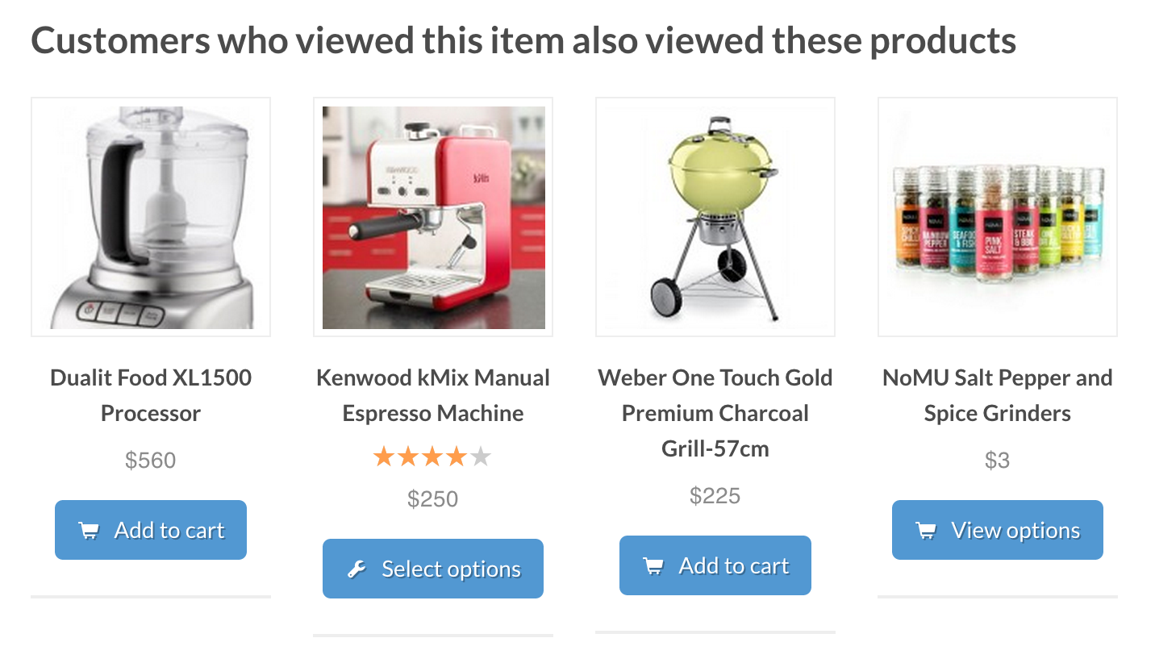




Recommendations based on Algorithms

Slide 17


Harrah’s Casino: Knowing your customer
Service provider of Gambling and Casinos
Entry Card
Pain points
Intervention
Reference: Supercrunchers
Notes:
for Lifetime Customer Value

Slide 18
What has been happening
1995
2005
2015
2025
Context: | Internet Web | Social Nets Recommend | Higher Accuracy Larger training | Control + AI Self learning
 | E-Commerce | Ad Driven Fin/Quant | Sharing Economy | ?

Slide 19
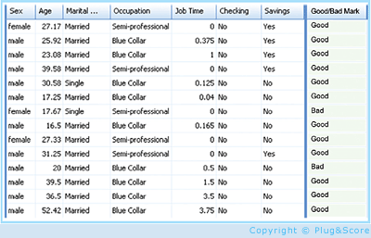
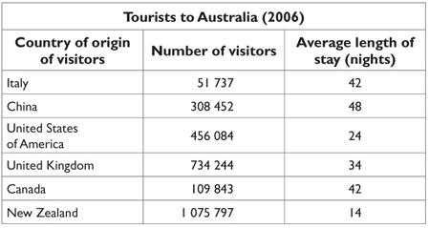
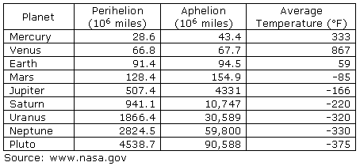
An ML High Level Framework
In Real Life
Features, but also loss of information
Some data has observed results
Objects
Events / Experiments
People / Customers
Products
Stocks
…
Person 1
Person 2
Person 3
.
.
.
Person N
In Sample
Out of Sample
- Characteristics
- Patterns
- Models
- Predictions
- Similarities
- Differences
- Distance

Slide 20
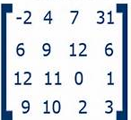
An ML High Level Framework
In Real Life
Features, but also loss of information
Some data has observed results
Objects
Events / Experiments
People / Customers
Products
Stocks
…
Person 1
Person 2
Person 3
.
.
.
Person N
In Sample
Out of Sample
- Characteristics
- Patterns
- Models
- Predictions
- Similarities
- Differences
- Distance
CS: Table
Math: Matrix X, with N rows – each person
m columns, each feature (age, salary, ..)
X =

Slide 21
A Fundamental Idea: From Table to N- Dimensional Space
Movie 2
Element | F1 | F2 | F3
A | 4 | 2 | 2
B | 4.5 | 1.5 | 3
C | 3 | 3 | 5
D | 1 | 2 | 2
E | 3 | 1.5 | 5
F | 3.5 | 3.5 | 1
.. | .. | .. | ..
Which user is closest to user A?
5
4
3
2
1
G
H
F
X =
D
C
A
B
E
1 2 3 4 5
Movie 1

Slide 22
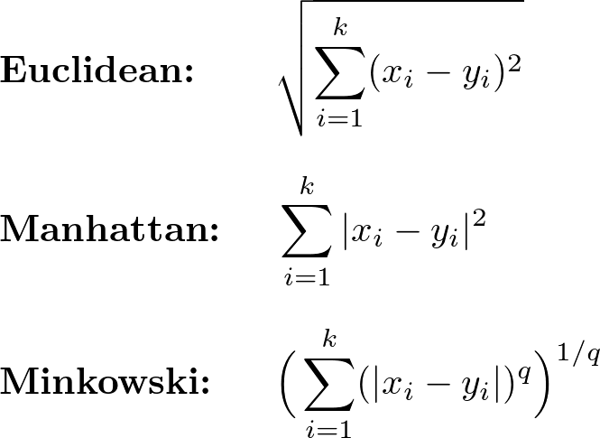
Clustering by Measuring Distance (Unsupervised)
Movie 2
Distance functions
5
4
3
2
1
G
H
F
D
C
A
E
B
Movie 1
1 2 3 4 5

Slide 23
Clustering to Classification
Feature 2
5
4
3
2
1
Target customers?
Pictures of Cats and Dogs
Speech recognition
Recognize Letters: A, B, C..
G
H
F
D
C
A
E
B
Feature 1
1 2 3 4 5
For Netflix: 70K -> 200K titles (dimensions), 10M plus users (points)
Factors: Accuracy vs Performance

Slide 24
A Fundamental Idea: From Table to Score
Cust | F1 | F2 | F3
A | 4 | 2 | 2
B | 4.5 | 1.5 | 3
C | 3 | 3 | 5
D | 1 | 2 | 2
E | 3 | 1.5 | 5
F | 3.5 | 3.5 | 1
.. | .. | .. | ..
Cust | Credit Score
A | 552
B | 381
C | 760
D | 330
E | 452
F | 678
.. | ..
F(X)
X =
X
Y

Slide 25
Machine Learning: Learning from Data
Input Data = Matrix X
Output Data = Column Vector Y
Customer 1: [Name, income, x, y, .. Features ..z]
Customer 2: [Name, income, x, y, .. Features ..z]
Customer N: [Name, income, x, y, .. Features ..z]
Customer 1: [20]
Customer 2: [60]
Customer N: [05]
Purchases/year, repaid loan, …
Target: What is F(X) = Y a formula that we don’t know
Sample data (training): (x1,y1) (x2,y2) … (xm,ym) we have this
Algorithm A from H
Find G(x) which is approx. F(x)
H: Hypothesis Set:
All possible algorithms or formulas
a) Supervised ML – as shown
b) Unsupervised - no training data
c) Reinforced learning – done by simulation

Slide 26
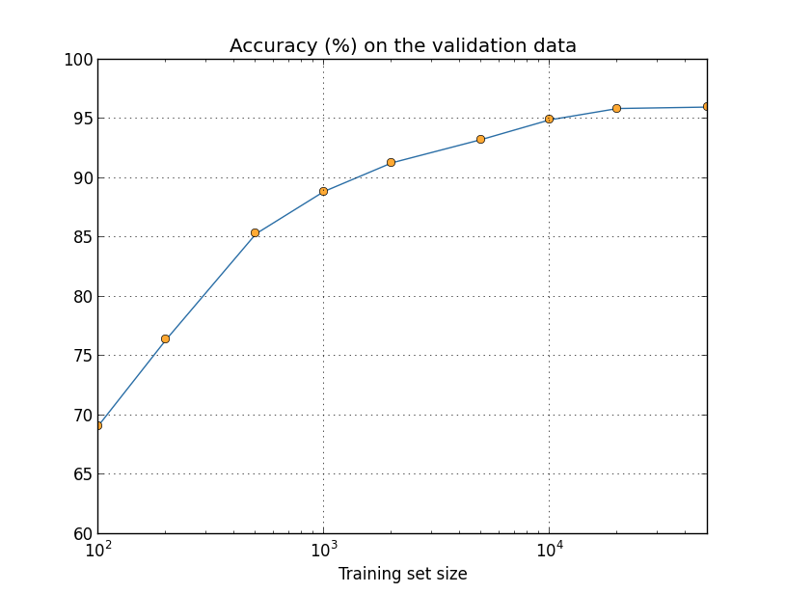

Slide 27

X
Y
X
Y

Slide 28
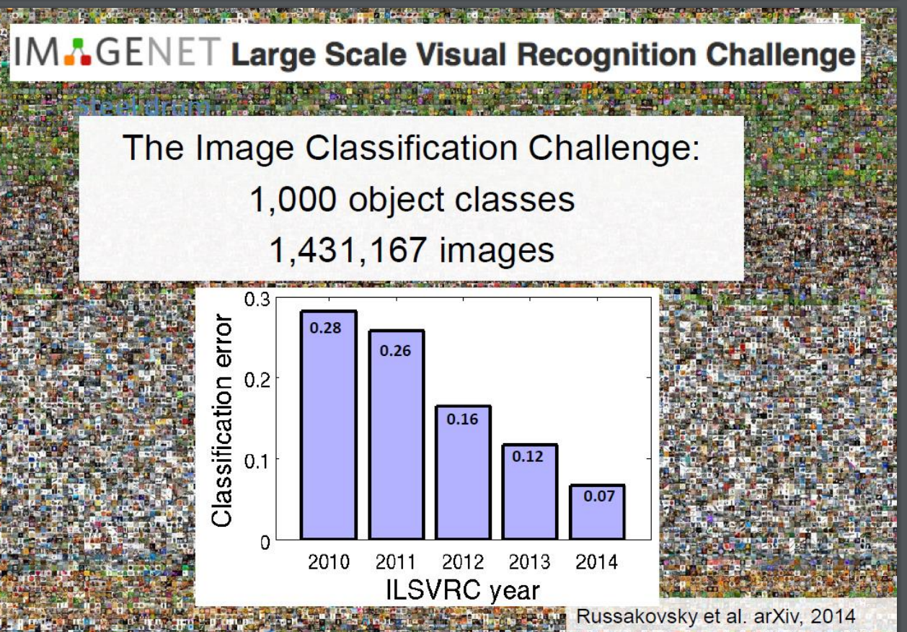
Neural net results are close to human results
The Key is multi-layer learning algorithms such as Deep Convolutional Neural Networks!

Slide 29
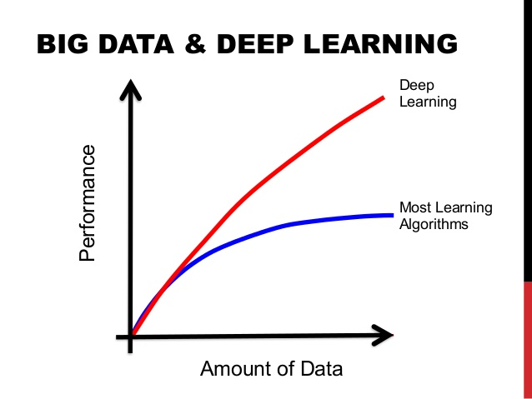
This means Accuracy

Slide 30
The Data-X System View
Possible Inputs Code Blocks
Possible Output Code Blocks
Compute including test, train, split
Web or Poll
Algorithm Options w/ Tables/Matrix
Prediction / Classification
Natural Language, State Space
Feature Extraction
Web
Download
Email
Stream
Social Net
Pandas: Short
Term Storage
Chatbot
…
…
Crawl
Long Term Storage: SQL and File Formats (JSON, CSV, Excel)
Control Decision
Feedback from External System (World)

Slide 31
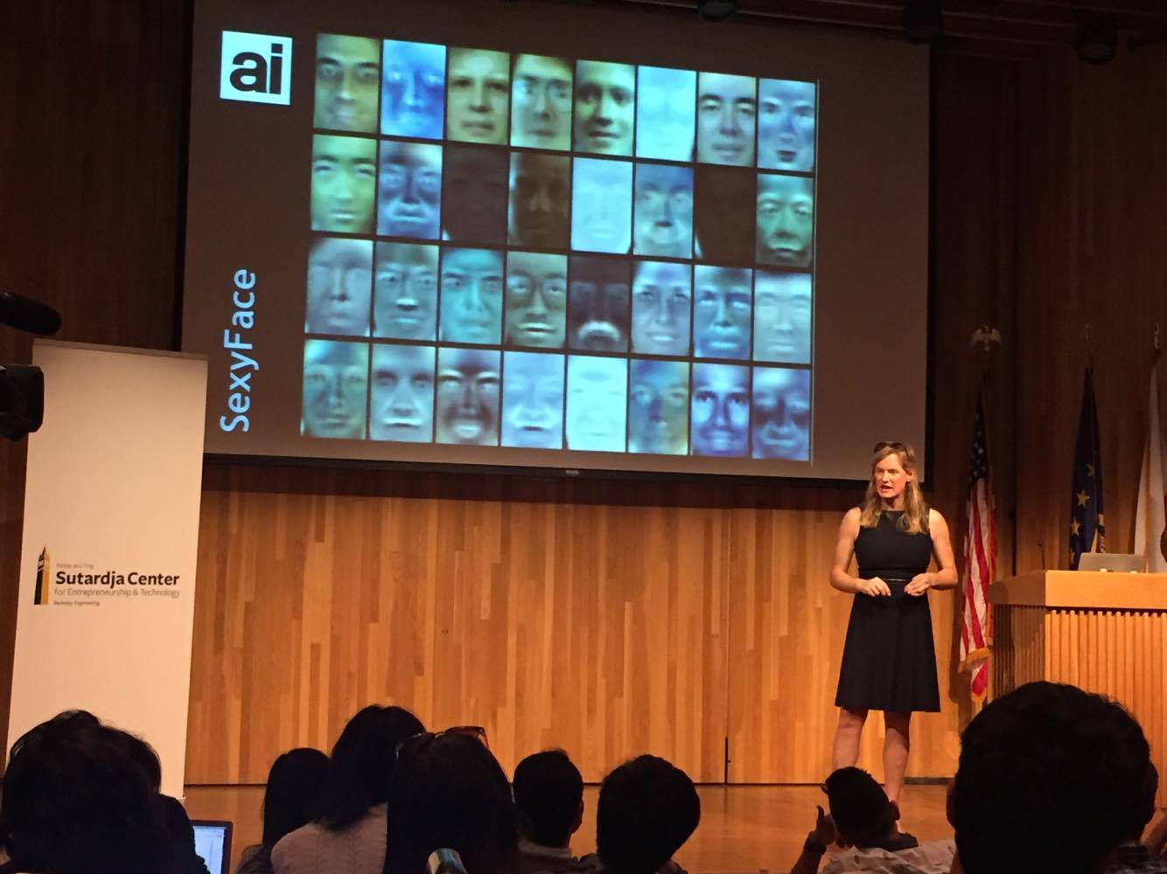
Vivienne Ming: Face Recognition for Finding Refugees in Camps

Slide 32






Top 8 Business Models Using Data
Knowing your customer, better targeting and relationship E.g. Target, Disney, Netflix
Improving physical product or servicer with complimentary information E.g. UPS, FedEx
Data-driven reliability or security E.g. GE, BMW, Siemens
Information Brokers, Arbitrage, and Trading Opportunities E.g. Investment funds.
Improving the customer journey/experience E.g. Harrah’s
Functional Applications: HR/Hiring, Operations etc. E.g. Walmart, Baseball, Sports
Efficiency or better performance per dollar cost E.g. General IT, SAP, etc
Risk Management, regulation, and compliance E.g. Compliance 360

Slide 33
Your Project Can also use a Data System for Social Impact
Financial inclusion
Health
Aid to underprivileged
Joining data for a research purpose
Justice
Environment
…

Slide 34
For Your Project – By Next week
Come up with 3 ideas for class projects in 1-3 sentences.
A systems or application you will build
Communicate: WHO the project is for, WHAT will it do, WHY this is needed/valuable.
Same instructions are in HW 1 Assignment

Slide 35
Reminder: A High Level Framework
In Real Life
Features, but also loss of information
Some data has observed results
Objects
Events / Experiments
People / Customers
Products
Stocks
…
Person 1
Person 2
Person 3
.
.
.
Person N
In Sample
Out of Sample
- Characteristics
- Patterns
- Models
- Predictions
- Similarities
- Differences
- Distance

Slide 36
A High Level Framework
In this class, we will learn ways to:
* Collect the data about objects
* Combine data sources when needed
* Use tables and databases to store
* Practice making good “features”
* Learn to Analyze; Compute, Classify, Predict
* Visualize some results
Use cookbook applications to get you started on your own applied project in a group.
In Real Life
Features, but also loss of information
Some data has observed results
Objects
Events / Experiments
People / Customers
Products
Stocks
…
Person 1
Person 2
Person 3
.
.
.
Person N
In Sample
Out of Sample
- Characteristics
- Patterns
- Models
- Predictions
- Similarities
- Differences
- Distance

Slide 37
End of Section

